Slide 1
Embedded Systems Design & Application(EC 3033)
Dr. J. K. Das

Slide 2
What is an Embedded System?
An embedded system is an applied computer system, as distinguished from other types of computer systems such as personal computers (PCs) or supercomputers.
However, the definition of “embedded system” is fluid and difficult to pin down, as it constantly evolves with advances in technology and dramatic decreases in the cost of implementing various hardware and software components.
Few of the more common descriptions of an embedded system are given in following slides:

Slide 3
descriptions of an embedded
Embedded systems are more limited in hardware and/or software functionality than a personal computer (PC). i.e. it can be taken as a subset of computer system limited in hardware resources which is nothing but limiting performance, power consumption, memory& hardware functionality etc. In terms of software relative to PC—have fewer applications, scaled-down applications, no operating system (OS) or a limited OS, or less abstraction-level code.
An embedded system is designed to perform a dedicated function. Most embedded devices are primarily designed for one specific function. devices such as personal data assistant (PDA)/cell phone hybrids, which are embedded systems designed to be able to do a variety of primary functions.
An embedded system is a computer system with higher quality and reliability requirements than other types of computer systems. Some families of embedded devices have a very high threshold of quality and reliability requirements. For example, if a car’s engine controller crashes while driving on a busy freeway or a critical medical device malfunctions during surgery, very serious problems result.

Slide 4
Definition of Embedded System
An Embedded System is a way of working, organizing or performing one or many tasks according to a fixed set of rules, program or plan.
or
It is an arrangement in which all units assemble and work together according to a program or plan.
For example:
Time display system - A watch
Automatic cloth washing system i.e: A washing machine.

Slide 5
Embedded Systems contd…
Definition(1):
An embedded system is a system that has software embedded into computer-hardware, which makes a system dedicated for an application (s) or specific part of an application or product or part of a larger system.
Definition(2):
An embedded system is one that has a dedicated purpose software embedded in a computer hardware.
Definition(3):
It is a dedicated computer based system for an application(s) or product. It may be an independent system or a part of large system. Its software usually embeds into a ROM (Read Only Memory) or flash.

Slide 6
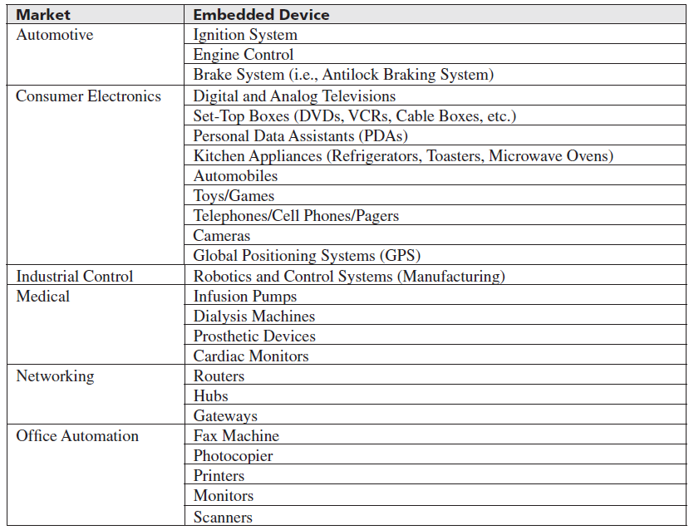
Examples of Embedded Systems and their Market

Slide 7
Computer versus Embedded System
A computer | An Embedded System
A computer is a system that has the following or more components. A microprocessor A large memory comprising the following two kinds: Primary memory (RAM, ROM etc.) Secondary memory (Hard disk, CDROM etc.) I/O units | It consists of three main components which are Embedded hardware to give computer like functionalities Embeds main application software generally into Flash or ROM and the application software performs concurrently the number of tasks. Embeds a real time operating system ( RTOS) for large system, which supervises the application software tasks running on the hardware and organizes the accesses to system resources according to priorities and timing constraints of tasks in the system.

Slide 8
Typical Example of an Embedded System- A Smart Card System

Slide 9
Embedded System Design Architecture
The architecture of an embedded system is an abstraction of the embedded device, meaning that it is a generalization of the system that typically doesn’t show detailed implementation information such as software source code or hardware circuit design.
At the architectural level, the hardware and software components in an embedded system are instead represented as some composition of interacting elements.
Elements are representations of hardware and/or software whose implementation details have been abstracted out, leaving only behavioral and inter-relationship information.
Architectural elements can be internally integrated within the embedded device, or exist externally to the embedded system and interact with internal elements.

Slide 10
Embedded System Design Architecture
Architecture-level information is physically represented in the form of structures.
A structure is one possible representation of the architecture, containing its own set of represented elements, properties, and inter-relationship information.
A structure is therefore a “snapshot” of the system’s hardware and software at design time and/or at run-time, given a particular environment and a given set of elements.
All structures within an architecture are inherently related to each other, and it is the sum of all these structures that is the embedded architecture of a device.

Slide 11
Embedded System Design Architecture contd…
Structure Types* | Definitions
Module
 | subsystem and component |  | Elements are defined as the different functional components within an embedded device.
 |  | Layers | Defines hierarchical embedded architectures in which different modules can use lower level modules
 |  | Kernels | Structure presents modules that use modules (services) of an operating system kernel or are manipulated by the kernel
 |  | Chanel architecture | Structure presents modules sequentially, showing the module transformations through their usages.
 |  | Virtual machines | Structure presents modules that use modules of a virtual machine
 | Decompositions |  | A type of modular structure in which some modules are actually subunits (decomposed units) of other modules, and inter-relations are indicated as such.
 | Class |  | This is a type of modular structure representing software and in which modules are referred to as classes, and inter-relationships are defined according to the object-oriented approach

Slide 12
Embedded System Design Architecture contd…
Structure Types* | Definitions
Component and Connector |  | These structures are composed of elements that are either components or connectors | These structures are composed of elements that are either components or connectors
 | Client/Server | Structure of system at runtime where components are clients or servers and connectors are the mechanisms used to intercommunicate between clients and servers. | Structure of system at runtime where components are clients or servers and connectors are the mechanisms used to intercommunicate between clients and servers.
 | Process | This structure is a SW structure of a system containing an operating system. Components are processes and/or threads, and their connecters are the inter-process communication mechanisms. | This structure is a SW structure of a system containing an operating system. Components are processes and/or threads, and their connecters are the inter-process communication mechanisms.
 | Concurrency and Resource | This structure is a runtime snap shot of a system containing an OS, and in which components are connected via threads running in parallel. Essentially, this structure is used for resource management. | This structure is a runtime snap shot of a system containing an OS, and in which components are connected via threads running in parallel. Essentially, this structure is used for resource management.
 |  | Interrupt | Structure represents the interrupt handling mechanisms in system.
 |  | Scheduling | Structure represents the task scheduling mechanism of threads demonstrating the fairness of the OS scheduler.
 | Memory |  | This runtime representation is of memory and data components with the memory allocation and deallocation --essentially the memory management scheme of the system.
 |  | Garbage Collection | This structure represents the garbage allocation scheme.
 |  | Allocation | This structure represents the memory allocation scheme of the system (static or dynamic, size, and so on).
 | Safety and Reliability | This structure is of the system at runtime in which redundant components and their intercommunication mechanisms demonstrate the reliability and safety of a system in the event of problems. | This structure is of the system at runtime in which redundant components and their intercommunication mechanisms demonstrate the reliability and safety of a system in the event of problems.

Slide 13
Embedded System Design Architecture contd…
Structure Types* | Definitions
Allocation |  | A structure representing relationships between SW and/or HW elements, and external elements in various environments.
 | Work Assignment | This structure assigns module responsibility to various development and design teams.
 | Implementation | This is a SW structure indicating where the SW is located on the development system’s file system.
 | Deployment | This structure is of the system at runtime where elements in this structure are HW and SW, and the relationship between elements are where the sw maps to in the hardware.

Slide 14
Embedded System Design Architecture
The architecture of an embedded system is an abstraction of the embedded device, meaning that it is a generalization of the system that typically doesn’t show detailed implementation information
At the architectural level, the hardware and software components in an embedded system are instead represented as some composition of interacting elements.
Elements are representations of hardware and/or software whose implementation details have been abstracted out, leaving only behavioral and inter-relationship information.
Architectural elements can be internally integrated within the embedded device, or exist externally to the embedded system and interact with internal elements.
In short, an embedded architecture includes elements of the embedded system, elements interacting with an embedded system, the properties of each of the individual elements, and the interactive relationships between the elements.

Slide 15
Importance of Embedded System Design Architecture
The architecture of embedded systems is so important because it is one of the most powerful tools that can be used to understand an embedded systems design or to resolve challenges faced when designing a new system. The most common of these challenges include:
defining and capturing the design of a system
cost limitations
determining a system’s integrity, such as reliability and safety
working within the confines of available elemental functionality (i.e., processing power, memory, battery life, etc.)
marketability and sellability
deterministic requirements
In short, an embedded systems architecture can be used to resolve these challenges early in a project. Without defining or knowing any of the internal implementation details, the architecture of an embedded device can be the first tool to be analyzed and used as a high-level blueprint defining the infrastructure of a design, possible design options, and design constraints. The Architectural design is a powerful approach as s its ability to informally and quickly communicate a design to a variety of people with or without technical backgrounds, even acting as a foundation in planning the project or actually designing a device.

Slide 16
Embedded System Design Process
When approaching embedded systems architecture design from a systems engineering point of view, several models can be applied to describe the cycle of embedded system design. Most of these models are based upon one or some combination of followings
the big-bang model, in which there is essentially no planning or processes in place before and during the development of a system.
The code-and-fix model, in which product requirements are defined but no formal processes are in place before the start of development.
The waterfall model, in which there is a process for developing a system in steps, where results of one step flow into the next step.
The spiral model, in which there is a process for developing a system in steps, and throughout the various steps, feedback is obtained and incorporated back into the process.

Slide 17
Embedded System Design Process- Life Cycle
Time flows from the left and proceeds through seven phases:
Product specification
Partitioning of the design into its software and hardware components
Iteration and refinement of the partitioning
Independent hardware and software design tasks
Integration of the hardware and software components
Product testing and release
On-going maintenance and upgrading

Slide 18
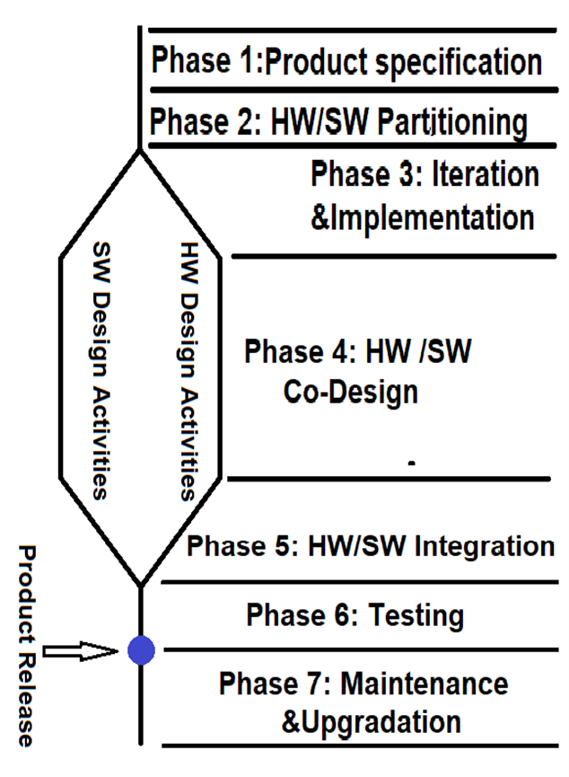
Embedded System Design Process- Life Cycle
The embedded design process is not as simple as Figure. A considerable amount of iteration and optimization occurs within phases and between phases.
Defects found in later stages often cause you to go back to previous stages.
For example, when product testing reveals performance deficiencies that render the design non-competitive, you might have to rewrite algorithms, redesign custom hardware .

Slide 19
Types of Embedded System

Slide 20
Classification of Embedded System (based on complexity)
Small Scale Embedded System:
These systems are built with 8 or 16 bit microcontrollers. Hardware complexity is less and software designed for it is resides in the memory available within the microcontroller to save power during operation.
Medium Scale Embedded System:
These are built around single or multiple microcontroller or DSP processor etc. with RISC instruction sets. It has both hardware and software complexities. external memory is used for storing the software for it.
Sophisticated Embedded System:
It has got higher hardware and software complexity than others. It also uses scalable or configurable processors. These type systems used for cutting edge applications that needs hardware and software co-design for integration into final system.

Slide 21
Classification of Embedded System (RTOS based)
Single-Functioned:
It usually dedicated for a specific function. The RTES is usually meant for very specific functions. Generally a special purpose microprocessor executes a program over and over again for a specific purpose. In this situation the system complexity very low.
Tightly Constrained:
The constraints on the design and marketability of RTES are more rigid than their non-real-time non-embedded counter parts. Time-domain constraints are the first thing that is taken care while developing such a system. Size, weight, power consumption and cost are the other major factors.
Reactive and Real Time:
Many embedded systems must continually react to changes in the systems environment and must compute certain results in real time immediately. For example, a cars cruise controller continually monitors and reacts to speed and brake sensors.

Slide 22
Advantage and Disadvantages
Advantage and Disadvantages
Advantages:
Smaller Size
Smaller Weight
Lower Power Consumption
Lower Electromagnetic Interference
Lower Price
Disadvantages:
Lower Mean Time Between Failure
Repair and Maintenance is not possible
Faster Obsolesce
Unmanageable Heat Loss
Difficult to Design

Slide 23
Embedded System Components
It embeds hardware similar to computer
Software usually embeds in the ROM, flash memory or a media card.
It embeds a real-time operating system (RTOS) which supervises the application software and controls the access to system resources.

Slide 24
Embedded System Components contd…
Power supply and power supply management unit
Power Source
System own supply with separate supply rails for IOs, clock, basic processor and memory and analog units, or
Supply from a system to which the embedded system interfaces, for example in a network card, or
Charge pump concept used in a system of little power needs, for examples, in the mouse or contact-less smart card.
Power Dissipation Management
Clever real-time programming by Wait and Stop instructions
Clever reduction of the clock rate during specific set of instructions
Optimizing the codes and
Clever enabling and disabling of use of caches or cache blocks

Slide 25
Embedded System Components contd…
Oscillator and reset circuitry
Appropriate clock oscillator circuit
Real Time Clock*( System Clock) and Timers driving hardware and software
Processor
Timers
Reset Circuit
Reset on Power-up
External and Internal Reset circuit
Reset on Timeout of Watchdog timer
Interrupt controller
Interrupt Handling element for the external port interrupts, IO interrupts, time
Input and output devices with their device drivers

Slide 26
Embedded System Components contd…
Program and data memory
RAM, ROM, EPROM, EEPROM etc.
Functions Assigned to the ROM or EPROM or Flash
Storing 'Application' program from where the processor fetches the instruction codes
Storing codes for system booting, initializing, Initial input data and Strings.
Storing Codes for RTOS.
Storing Pointers (addresses) of various service routines.
Functions Assigned to the Internal, External and Buffer RAM
Storing the variables during program run,
Storing the stacks,
Storing input or output buffers for example, for speech or image
Functions Assigned to the EEPROM or Flash
Storing non-volatile results of processing

Slide 27
Embedded System Components contd…
Communication ports
Communication Driver(s) : Network Ethernet or serial driver to communicate with host embedded system Expansion Facility, SCSI
Other Components:
Media IO Control Element, Keypad or Keyboard IO Interface, LCD Display System Interface, e. ADC – Single or Multi channel, DAC, GPIB Interface Element, Pulse Dialling Element, Modem, Bluetooth, 802.11, IrDA, ..

Slide 28
Embedded Processors in the Systems
Processor in an embedded system is the heart of the system. Processor in embedded system can be of followings:
Single Processor ( A VLSI Chip)
A core in an ASIP
A core in ASIC
A core in SoC
The processor chip or core in an embedded System may be
Microprocessor or Embedded Processor: A General Purpose Processor (GPP) having instructions set designed not to specific purpose. For example Intel Pentium Processor
Application Specific Instruction Set Processor (ASIP) : A VLSI chip or a core designed for a particular application. For example:
Microcontroller
DSP Processor
Single processor as an additional processor: Coprocessor, Accelerator, GPP, or ASIP Core.

Slide 29
Processors in Embedded Systems
Microprocessor:
A VLSI chip having CPU and other components like cache, floating point unit, pipeline or superscalar units. CPU fetches instruction and process a set of instruction. It may use multiple threads and cores to achieve desired functionality.
Microcontroller:
It is an integrated VLSI chip or SoC and it has a Processor, memory and several other units integrated together.
Figure in next slide shows the functional circuits present(in solid boundary boxes)in a microcontroller, The figure also shows the application-specific units(in dashed boundary boxes).These units are present in a specific version of a given microcontroller family.

Slide 30
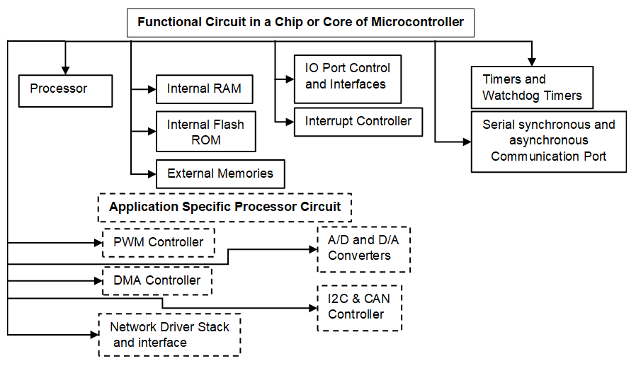
Microcontroller
Just as a microprocessor or processor is the essential part of a computing system, a microcontroller is the essential component of a control or communication circuit.
A microcontroller is a single-chip VLSI unit (also called microcomputer'), which, though having limited computational capabilities, possesses enhanced input-output capabilities and has a number of on-chip functional units.

Slide 31
General Purpose Processor
It is programmable digital system intended to solve computational task in large variety of applications.
Using it gives several advantage like low unit cost.
The basic architecture of a GPP is shown in figure.

Slide 32
General Purpose Processor – Datapath
It consists of circuitry for transforming data and for storing temporary data.
It contains an ALU that performs arithmetic and logic operations.
It contains registers for storing temporary data during data manipulations.
It is connected to internal data bus for internal operation and external data bus for data reading and storing to and from externa memory.
Common processor data path sizes available is 4-bit, 8-bit,16-bit, 32-bit & 64-bit.

Slide 33
General Purpose Processor – Controller
Control circuitry generally handles instructions, moving data to and from and through data path according to instruction sets.
It consists of PC(program counter) that holds the address of next instruction.
It contains instruction register(IR) to hold the fetched instruction.
Based on IR value, controller generates appropriate control signal for flow of data in data path.
The next state logic determines the next value of PC.
PC width is equal to address bus width not necessarily same as data bus
Controller generates a sequence of instructions to in different phases: fetch, decode and execute.

Slide 34
General Purpose Processor – Memory
While registers act as short term storage device, memory serves as processor's medium and long-term storage requirements- data memory and program memory.
Memory can be connected in two way: Harvard Architecture(separate data and program memory), Princeton Architecture(Von-Neuman- single memory for both data and program)
Memory may be on-chip and off-chip memory.
Reduce the access time of memory a local copy of the memory can be kept in small and fast memory called cache memory inside the processor.
When a copy of memory found in cache memory, a hit will occur otherwise a miss will occur.

Slide 35
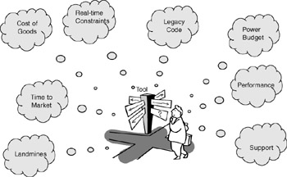
Processor selection for Embedded System Design
Considerations for choosing the right processor for an embedded application following questions are important:
Is it available in a suitable implementation?
Cost-sensitive projects might require an off-the-shelf, highly integrated part or High-performance applications might require less delay which is only practical when the entire design is fabricated on a single chip. What good is choosing the highest performing processor if the cost is within range makes your product noncompetitive in the marketplace?
For example, industrial control equipment manufacturers that commonly provide product support and replacement parts with a 20-year lifetime won’t choose a microprocessor from a vendor that can’t guarantee product availability over a reasonable span of time.
Similarly, if a processor isn’t available in a military version, you wouldn’t choose it for a missile guidance system, no matter how good the specs are. In many cases, packaging and implementation technology issues significantly limit the choice of architecture and instruction set.
Fig: Choosing the Right Processor

Slide 36
Processor selection for Embedded System Design
Is it capable of sufficient performance?
Ultimately, the processor must be able to do the job on time. Unfortunately, as embedded systems become more complex, characterizing “the job” becomes more difficult. As the mix of tasks managed by the processor becomes more diverse, the bottlenecks that limit performance often have less to do with computational power than with the “fit” between the architecture and the device’s more demanding tasks. For this reason, it can be difficult to correlate benchmark results with how a processor will perform in a particular device.
Is it supported by a suitable operating system?
With today’s 32-bit microprocessors, it’s natural to see an advantage in choosing a commercial RTOS. Porting the RTOS kernel to a new or different microprocessor architecture and having it specifically optimized to take advantage of the low-level performance features of that microprocessor is not a task for the faint-hearted. So, the microprocessor selection also might depend on having support for the customer’s preferred RTOS.

Slide 37
Processor selection for Embedded System Design
Is it supported by appropriate and adequate tools?
Good tools are critical to project success. The specific toolset necessary depends on the nature of the project to a certain extent. At a minimum, you’ll need a good cross-compiler and good debugging support. In many situations, you’ll need far more, such as in-circuit emulators (ICE), simulators, and so on.

Slide 38
DSP Processor and VLIW Architecture
A specialized microprocessor for Realtime DSP applications
Digital filtering (FIR and IIR)
FFT
Convolution, Matrix Multiplication etc
Common DSP features
Harvard architecture
Dedicated single cycle Multiply Accumulate (MAC) instruction (hardware MAC
Single Instruction Multiple Data (SIMD) Very Large Instruction Word (VLIW) architecture
Pipelining
Saturation arithmetic
Zero overhead looping
Hardware circular addressing
Cache
DMA

Slide 39
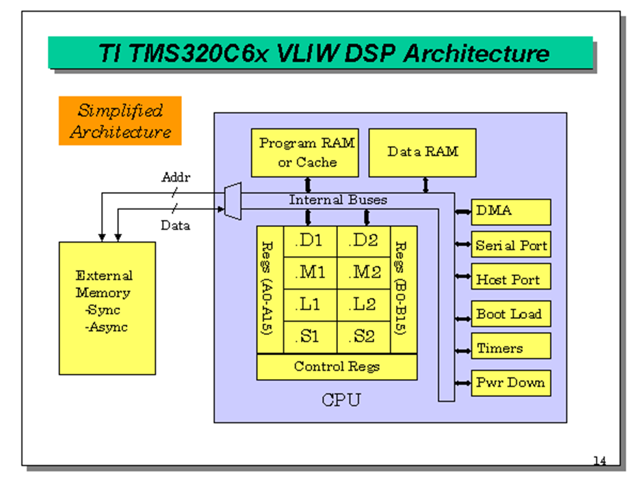
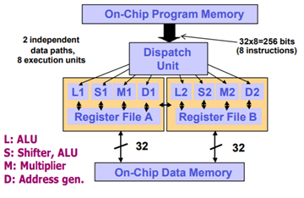
Single Instruction Multiple Data & Very Long Instruction Word (VLIW)
A technique for data level parallelism by employing a number of processing elements working in parallel
A technique for instruction-level parallelism by executing instructions without dependencies (known at compile-time) in parallel

Slide 40
SoC- System on Chip
A complex Embedded system design done on a single Silicon Chip consisting of different processors, Ips, and other Peripherals which is called as SoC i.e. System on Chip.
An SoC may contains following components which are interconnected to act as single chip:
GPP
SPP
DSP processor
Memory
IPs
ADC and DAC, other Analog Circuits,
Timer, bus interface units
Memory subsystems- Ram, ROM, EPROM, Flash and
Many more
The figure in next slide shows a SoC Chip and as an example ARM Processor is shown in figure.

Slide 41
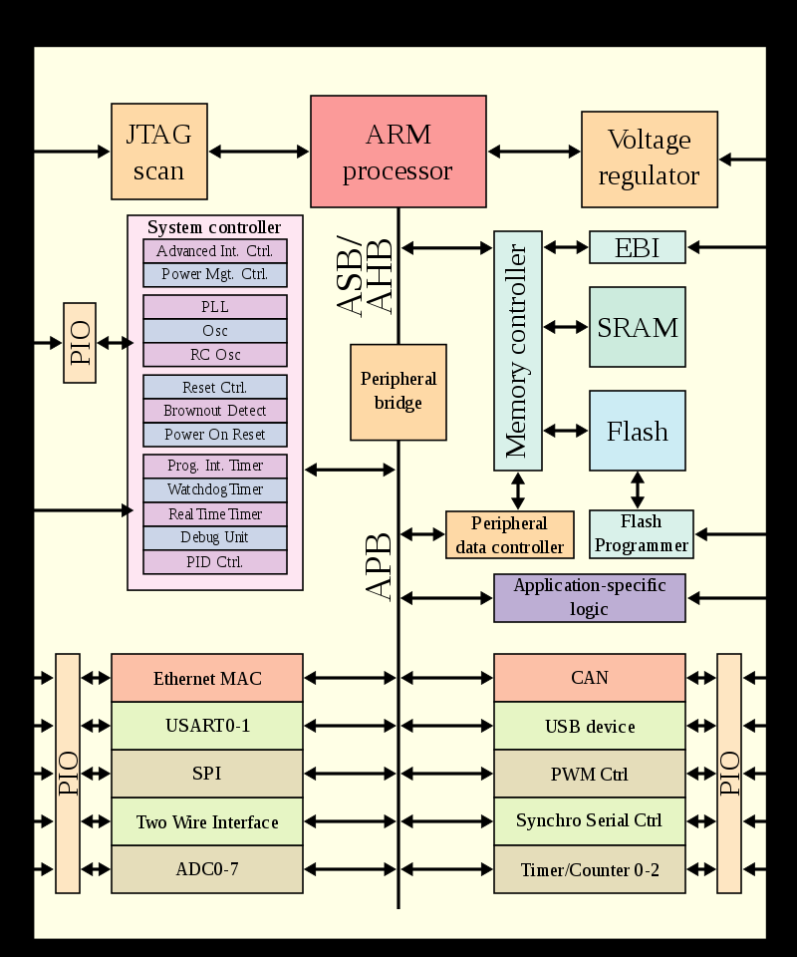
SoC Diagram
General SoC Diagram
ARM SoC

Slide 42
SoC
Advantages of SoC are
Less area
Low power consumption
Higher performance
Some uses of SoC are
Mobile phones
Tablets
Digital TVs and Camera
Set-top boxes
Network Modules

Slide 43
Features of Embedded System
Single functioned system
Most of embedded system designed have single function purpose only.
Interaction with physical environment
Embedded system interacts with the physical environments around them.
User interface
Unlike common user interfaces like keyboard, mouse etc. embedded system sometimes contain dedicated user interfaces for a specific operation like switching on /off display.
Dependable system
When embedded systems are used for safety critical purpose like in nuclear plants where to ensure easy maintainability, and provides high security.

Slide 44
Features of Embedded System
Tightly constrained system
Embedded systems designed so often constrained by size and power consumption where these are vital important.
Real time system
Most of embedded system often work in real-time for safety where time is an important factor for finishing process of different responses in time.
Hybrid system
Often embedded system contains both analog and digital system in it called hybrid system.
Reactive system
It must be reactive to physical environment for its different functionality.

Slide 45
Design Metrics
System Cost
Size
Performance
Power requirements
Design flexibility
Design turnaround time
System maintainability
Testing and verification of functionality.

Slide 46
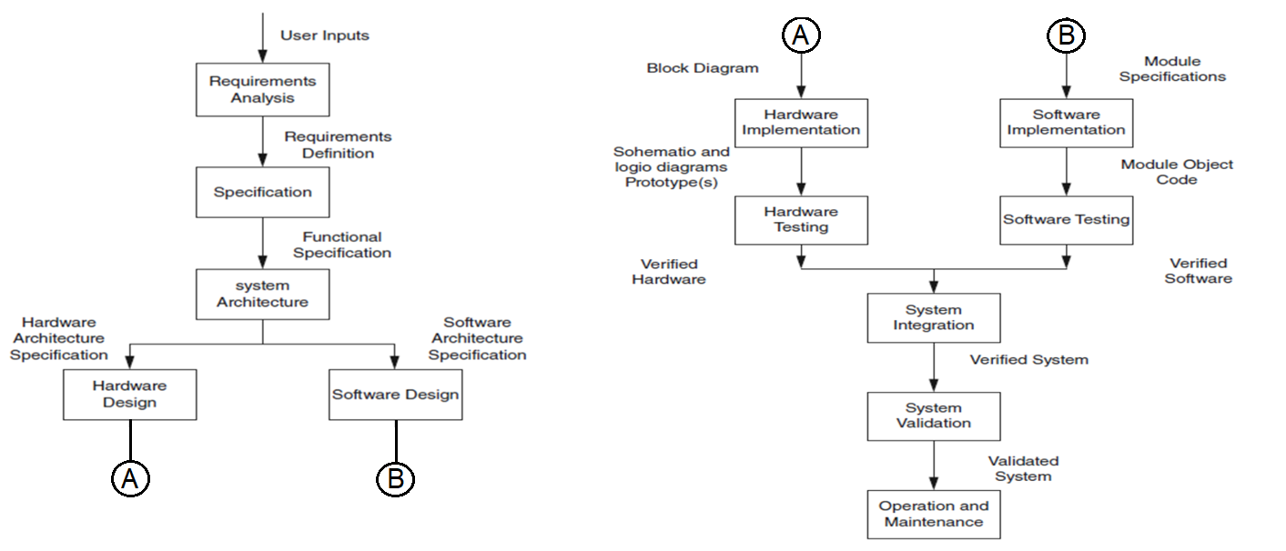
Embedded System Design Flow(Traditional Design Flow)
Details description

Slide 47
Embedded System Design Flow(Traditional Design Flow)
In traditional embedded system design process, they share a common structures and common development cycle.
Figure 1 shows the typically embedded system design cycle.
This process involves many components, PCBs and the system.
The software design involves high level assembly language that requires the knowledge of microprocessor / microcontroller architecture and register structure.
The design process breaks the system into hardware and software components
Each components are designed separately by separate teams and generally hw development lags behind the software development.
Such an approach limits the hardware-software tradeoffs and interaction between them are determined or discovered later in the system development.
In this development process concurrency between hardware and software components and greater cooperation between all designers’ leads to shorter design cycle time.

Slide 48
Embedded System Design Flow (Hardware-Software Co- Design)

Slide 49
Requirement and specification
Requirement identification process is to capture the formal description of the complete system from costumer’s point of view and these documented properly using different definitions and descriptions.
In subsequent process, these documentation acts as design specifications and these specifications are then analysed taking environment conditions.
Based on analysis, an overview of the system is formulated in the following perspective:
Functional view- defines system internal functions and relationship among those function
Operational view- captures and express the behaviour of those functions
Technology view-Formulates a hardware and software solution to the problem, identifies the components comprising solution, and the implementation of the functional behavior on the hardware that is consistent with the identified constraints.
For the system and based upon above perspectives, three types of specification:
functional specification- The functional specification enumerates and describes the functions or operations to be performed by system on or in the environment.
operational specification- The operational specification focuses on the behavior, performance, information details, methods and approaches to be used in system and
technical specification-The technological specification includes high-level timing and timing constraints, geographic distribution constraints, characteristics of the interface, and implementation constraints
are proposed.

Slide 50
Hardware – Software Co-Design
The HW-SW codesign process is carried out in following manner-
Identification of major functional blocks in the system
Partitioning the functions into HW and SW components
Refining inter-process communication
Modeling the HW and software functions
Formulating the HW architecture
Making Co-simulation
Synthesizing the HW and its interface
Software synthesis –target specific task for hw components
HW – synthesis – decomposing computational steps into clocks
Co-simulation
Co-verifications - used for testing HW & SW bugs during design

Slide 51
Functional Decomposition
System is decomposed / partitioned so that function of each module is easy to understand
Each module should have we defined function and interconnects
modules should be independent as far as possible
This is done to solve the complexity of the system and easy to organize hierarchical modules.

Slide 52
Decomposing the system Design
After deciding formal specification for detailed design and implementation, decomposing of different major functions is done to support design implementation: Goals:
Utilize strategies for developing the design solution from well-defined statement of problem.
Use a variety of tools to aide in rendering the system’s complexity understandable and tractable.
To attack the complexity of by partitioning into modules and organizing the modules into hierarchies.
Begin to establish criteria for evaluating the quality, reliability, and safety of the design.
To manage the complexity of the design, partitioning or decomposing the initial high-level view into modules is done.
Each module should solve one well defined piece of the problem.
Partitioning should be done so that connections between modules are only introduced because of connections between pieces of problem.
Partitioning should assure that connections between modules are as independent aspossible.

Slide 53
MAPPING TO AN ARCHITECTURE
The purpose at this stage in the development cycle is to find an appropriate internal functional architecture for the system.
Defining architecture from the portioning or decomposition process, two terms comes int mind are : coupling and cohesion.
Coupling
Coupling defines how far different modules are independent and as independence increases, it facilitates followings:
Easy for Debugging the design during development.
Adds flexibility in Troubleshooting & Maintaining the modules and system.
enables to new features to the system.
Ensuring a secure system.
The independence can be done in following ways:
Eliminate all unessential interaction between modules.
Minimize the amount of essential interaction between modules.
Loosen the essential interaction between modules, if possible.

Slide 54
MAPPING TO AN ARCHITECTURE
Cohesion
Cohesion is a measure of strength of the functional relatedness of elements in a module. The goal is to create strong, highly cohesive modules whose elements are genuinely and tightly related to one another.
Functional cohesion.
Sequential cohesion.
Communicational cohesion.
Procedural cohesion.
Temporal cohesion.
Logical cohesion.
Coincidental cohesion.
There are a variety of different methods by which the partitioning is done. there are two extremes: a software-oriented model and a hardware-oriented model.
The former initially puts everything into software while moving time critical pieces of functionality to hardware as necessary to meet time or speed constraints. The latter initially puts everything into hardware while moving non-time critical pieces of functionality to software as appropriate to meet cost constraints.
After doing successful partitioning or decompositions, now the architecture of the system is decided based on portioned or decomposed components which are arranged in proper manner to describe the complete embedded system.

Slide 55
What we learnt
What is an Embedded System?
Embedded Design Life cycle
Embedded Design Flow
Classification of Embedded System
Features and design Metrics of Embedded System

Slide 56
Possible Question
What is an Embedded System?
In what way Embedded System is different from a general purpose computer or differentiate between Embedded System and a general purpose computer?
Briefly explain the features of a typical embedded system.
Why Embedded System architecture so important?
Classify embedded system based on processor used.
Classify embedded system based on operating system used.
With neat diagram explain different parts of an embedded system.
State different applications of an embedded system.
With neat diagram explain the lifecycle of an embedded system.
With neat diagram explain a typical embedded system design flow.
What is the use of in-system-simulator?
List the common components used in microprocessor, microcontroller and other processors used in Embedded System.
List different types of memory used in embedded system and differentiate between them.
How cache memory is different from main memory?
With neat diagram explain the architecture of following embedded systems:
Smart Card System, Digital camera, Automatic Tailor Machine and Automatic Chocolate Vending Machine

